Slide 1
Managing the Unexpected: Stressors and Solutions for Challenges Experienced by RN-BSN Students During an Unprecedented Global Pandemic
Debra A. Hrelic PhD, RN-C
Jane G. Anderson DNP, G-CNS-BC, CNE
August 6, 2021 1-2:30pm

Slide 2
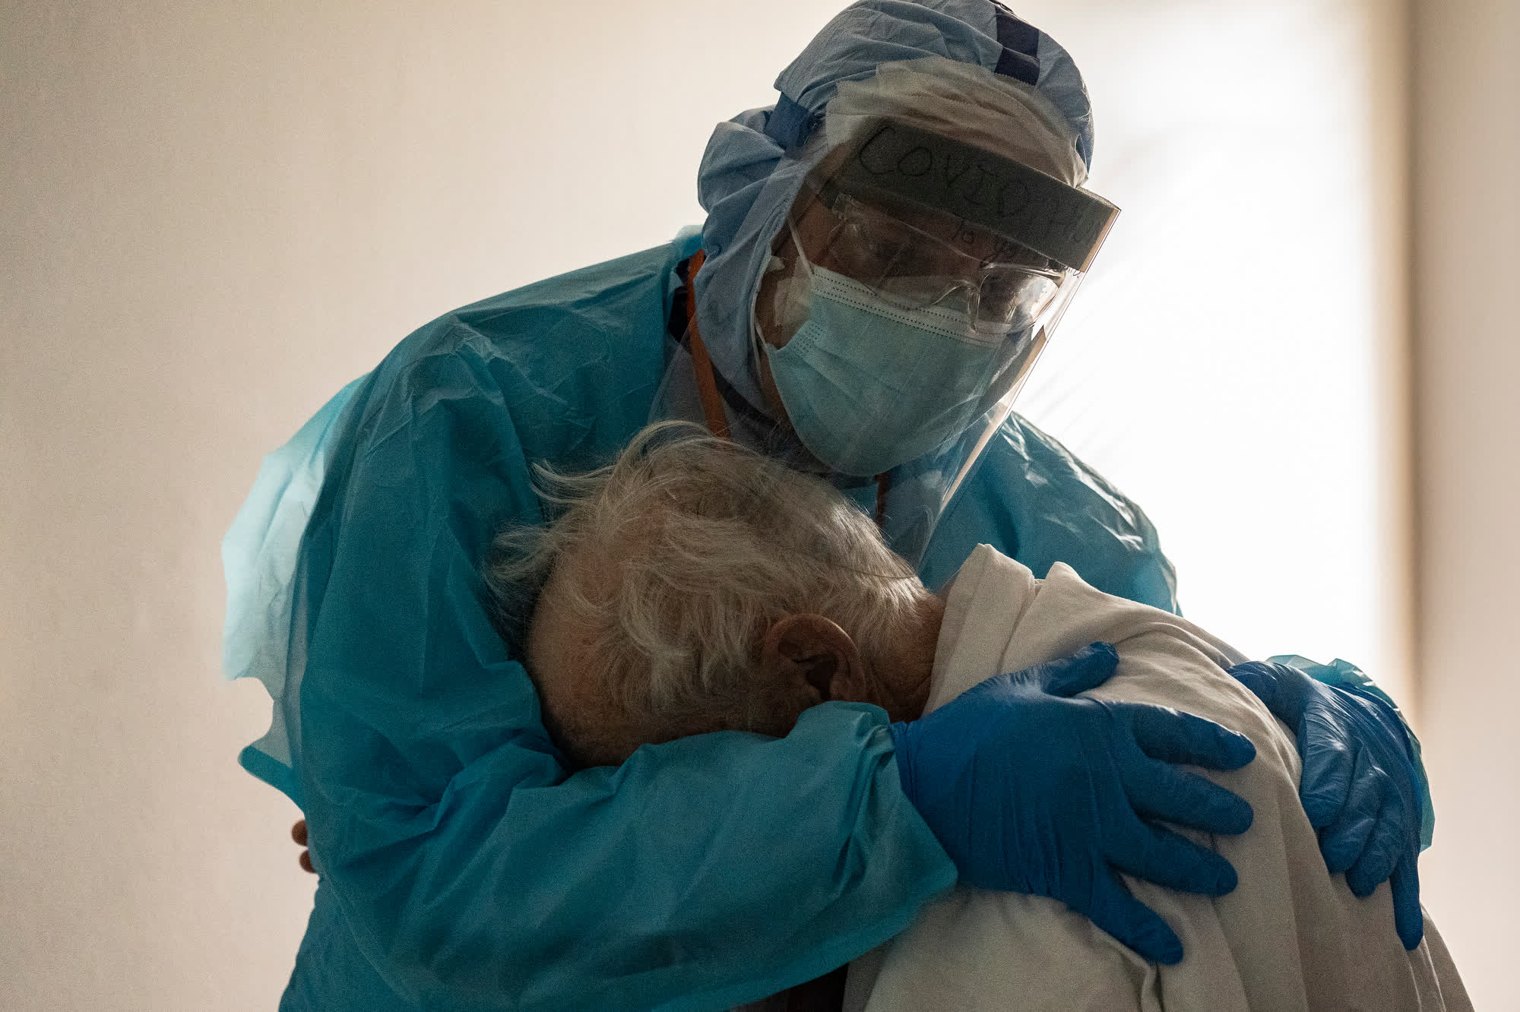
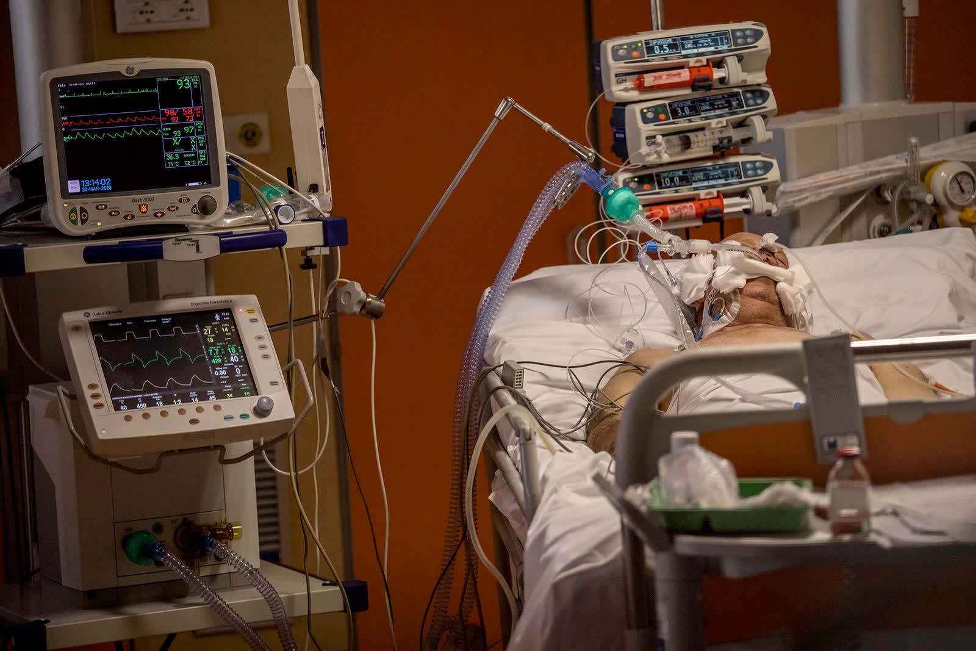
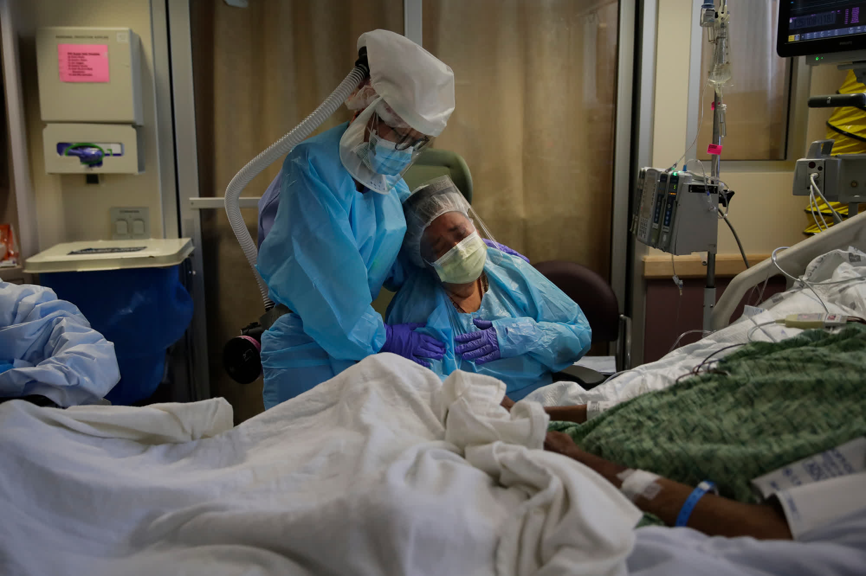
Notes:
The year 2020 has brought the world the Coronavirus and a global pandemic. I’m sure these pictures, and many like them are familiar sights for us all!
Nurses worldwide have been on the frontlines fighting this pandemic as essential workers. Many have been, and still are, working long hours, some with mandatory overtime. They are giving generously of their time, and their hearts, to serve their communities, employers, patients, and families. Some of these registered nurses (RNs) are also attending classes online in accelerated programs to earn their Baccalaureate degrees in Nursing during this pandemic. This is a choice by some, but for others, it is a timed mandate by their employers. Attending school as a working RN is a stressful event by itself, but during an active pandemic it can be overwhelmingly stressful. Before long the coronavirus, soon named COVID-19, proved to be a formidable opponent.
Many academic programs suffered, and nursing programs were NOT spared! Throughout the United states colleges and universities either closed or were forced to move their classes from Face-to Face formats to On-line formats. This was not only a major adjustment for faculty, who had to re-configure the format of classes while maintaining course integrity and student learning outcomes. But it also proved to be a monumental leap for students who were accustomed to attending class in-person and now had to be self-motivated without the active connection to their class and their professor. For many this proved very difficult.
In contrast, one might think that if an academic program was online prior to the pandemic, then it should be “business as usual,” without any changes needed during the pandemic. That depends on the educational degree and the student population. In our southeastern university’s online accelerated program, for registered nurses (RNs), that was not the case at all. As the COVID-19 pandemic continued, our students began to show noticeable struggles with their coursework.

Slide 3
Recognizing and Intervening During a Downward Spiral: Challenges and Struggles for RN-BSN Students During Pandemic
TERM | WE | F/WF
Spring 1, 2020 | 5 | 57
Spring 2, 2020 | 17 | 25
Summer 1, 2020 | 8 | 28
Summer 2, 2020 | 6 | 44
Fall 1, 2020 | 4 | 42
Fall 2, 2020 | 16 | 48
Spring 1, 2021 | 66 | --
Spring 2, 2021 | 73 | 1
Notes:
In late 2020 and into 2021 RN-BSN faculty noticed a downward spiral of academic grades in the program, with an increase in student disengagement, failing grades, class withdrawals (W) and withdrawals for extenuating circumstances (WE). These are evidenced in this table by WE's, F's and WF's.
This was occurring at a time when the COVID-19 pandemic was peaking in the southeast and students frequently reported working extra hours and shifts, missing course deadlines, and were uncharacteristicly either “inattentive” to their assignments or simply stopped responding to course activities and faculty inquiries entirely. Faculty, as a collective, became concerned and decided that immediate action was needed. Many of the RN students notified faculty of mandatory overtime requirements and time constraints for caring for family members who were ill. Others reported supervising children in a homeschool situation. Several of the students became infected with the virus themselves, while others were frightened, they would expose their families (Shigemura et al., 2020). Additionally, the RN students voiced concern that they must complete their BSN degree by a contracted time set by their employers or state law. Yet these nurses persevered. Faculty struggled in how to support these students, who are frontline heroes, in the educational online setting.
(particularly evident were: the F's/WF's in Summer 2 of 2020 and Fall 1 and 2 of 2020, and then the WEs in spring 1 and 2 of 2021, and Fs and Ws in Fall 1&2 of 2020).

Slide 4
Notes:
When queried as to the “biggest challenge or struggle” during the Covid pandemic 302 RN-BSN students voluntarily participated in the distributed Qualtrics study. Since they were encouraged to select ALL of the stressors that applied to them, 1105 responses were received and many explanations and elaborations were provided by participants.
The 4 most common stressors were:
Work Responsibilities – receiving 208 out of 1105 total responses. Students described “working more than 60 hours a week” “mandatory overtime” “having to work to cover co-workers Covid illnesses” “ working in high stress environments such as ICU” and “having to go in early, work through lunch and staying late.” Others talked about “having so many staff out with COVID reasons that they are working overtime every week, sometimes 5 – 6 fourteen hour shifts a week.”. Simply put “just can’t keep up.”
Having to take care of people who depend on me while I am in school – receiving 183 out of 1105. “caring for aging parents.” “dealing with the loss of family members due to Covid…inability to grieve…additional financial responsibilities, stress, grief,” & “3 kids at home doing online school, constant distraction.” One student described losing a grandmother in July, an uncle n December another grandmother in Feb. They all got Covid. Can’t be with family, no wake, go to funerals. There is no closure.”
Keeping up academically – receiving 143 of 1105. Extreme fatigue (both physical & mental) and lack of time were prominent reasons for academic concerns. Students stated “I used to do schoolwork while they were at school, I can’t now, I can’t sleep before I go to work, It’s a huge distraction, I’m exhausted, I have no time.” “I’m very stressed with the mandatory overtime at work & trying to get schoolwork in on time. I’m so fatigued when I get home, I fall asleep trying to complete it, or to do the reading required.” Students feel as if they are “getting the work done just to get it done, and not benefiting from it.” “Stresses of the pandemic, working OT and family…make school harder.”
Sress d/t anxidety/lonliness or other mental stress – 123 of 1105. a reiteration of previous claims of overwhelming life events, unresolved grief, managing home issues and work demands that the isolation forced on them due to the pandemic. “childcare is harder because people are sick or wary.”

Slide 5
Notes:
In our survey faculty proposed 3 potential stress reduction interventions to students and requested participants to suggest others for consideration. Of the 302 students who voluntarily participated in the Qualtrics survey, 505 responses were received, since once again students were encouraged to select all that apply.
Not having both discussion board & major assignment assigned - 245 out of 505 responses. (describe how classes are formatted). Students agreed that “having major assignments & discussion boards in one week is too much at times.” Consensus appears to be “1 discussion board peer response instead of two” and “two is a lot to handle when you have multiple classes each with a DB, quiz, and additional assignment.” DBs are considered very time consuming because they require APA format and citations & references. It was felt that “reducing the number of response posts to DBs to 1 or none on weeks that are more assignment heavy” would be most helpful in reducing student stress.
A one-time “stuff happens pass” - was another extremely popular option with students. This drew 175 of 505 responses. Students voiced frequently having to “skip sleep” so they could “work on a project or complete an assignment.” “A stuff happens pass would be great for the times when it is difficult to manage work, school and home life.” Students considered it a “grace period” on assignments.
Using video submission for a discussion board assignment instead of writing – this was the least favorite of the suggestions offered by faculty, receiving a mere 15 of the total 505. Students voiced “being uncomfortable with the format and platform itself.” One said, “I spend 48 hours a week at work having to put on my happy face and making my voice encouraging and enthusiastic. Writing assignments allow me to just write and express myself without having the excess stress of being presentable and using mediums that I’m uncomfortable with.” The majority of students felt that “video submissions would be MORE work!”

Slide 6
Student Suggestions:
Honor deadlines in student time zones
Elimination of group projects
Avoid video/audio assignments
“Optional” group projects
Option for alternate formats, PPTs, videos instead of papers *
Eliminate discussion boards
Discussion board with no peer response
No citations, no APA, required for discussion boards
Eliminate due dates for assignments, as long as they are turned in by end of course
Suggested deadlines for work, no hard stop times
Flexible assignment submissions throughout semester
Work at your own pace
Notes:
As you can see, while reviewing some of the student suggestions for academic stress release during the pandemic, some of their proposals can be considered feasible while others are not really feasible at all.
As an educator, it would be very difficult to have a class of 25 or 30 students, with several assignments during a semester, and then have flexible (or better yet) no due dates. Just have your students do their work at their own pace as long as they complete it before the class ends… that would be interesting wouldn’t it?
Imagine trying to grade all of those assignments, handed in on the last day of class, before grades are due????

Slide 7
CORE NURSING COURSE | COMPASSIONATE INTERVENTIONS EMPLOYED
Professional Nursing Practice for the Baccalaureate Nurse | 1 peer response to DB (discussion board) instead of 2, all DBs “Stuff happens” pass
Gerontological Nursing & the End-of-Life Care | “Stuff happens” pass
Health Assessment for Registered Nurses | 1 peer response to DB instead of 2 “Stuff happens” pass
Health Policy | 1 wk ONLY DB is due 1 wk no DB, only presentation is due 1 wk nothing is due 1 wk ONLY virtual presentation is due
Leadership & Management in Nursing for the Professional Nurse | 1 peer response to DB instead of 2, all DBs Alternate format, PPT with voiceover is offered to written assignment “Stuff happens” pass
Population & Community Health Nursing | “Stuff happens” pass
Research in Nursing | 1 peer response to DB instead of 2, all DBs “Stuff happens” pass
Pathophysiologic & Pharmacological Evidence Based Nursing Care | Option for group work, or alternate format assignment 1 peer response to DB instead of 2, all DBs “Stuff happens” pass
Professional Nursing Capstone | 1 wk DB with no responses “Stuff happens” pass
Notes:
What we did do, was this:
Faculty met, and a thorough analysis of participant responses to the Qualtrics Student Stress Survey was done with the goal of determining which compassionate strategies and interventions would be employed in each of the nursing core classes to aide in the reduction student stress.
It was decided that each nursing core class would employ one or more compassionate strategies and interventions to help decrease the academic stress suffered by our RN-BSN students. Interventions began immediately in our Spring 2 session.
After 16 weeks (completion of 2 7-week sessions, and 2 weeks into the 3rd session, a Qualtrics RN-BSN Stress Follow-up survey was given to our RN-BSN students. 276 students voluntarily decided to participate in this study, and now Jane Anderson will take over and share our results with you. She will discuss Evaluating interventions and implications for future practice

Slide 8
Timing of the Follow up Survey
Sent early June to graduates
Selected early in the Summer 2 term
Avoiding end of a course
Timed before working on final projects and papers

Slide 9
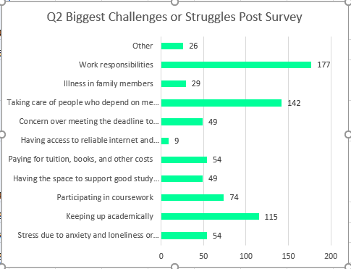
Notes:
When students were presented with the “Qualtrics RN-BSN Stress Follow-up Survey”, the post-survey, 16 weeks after they had participated in the pre-survey, 276 students participated in the post-survey. Again, they were instructed to select all that applied. A total of 778 responses were logged in to question # 2 asking students which of the originally identified challenges remained a stressor for them at this stage of the pandemic. In the post-survey three of their biggest concerns in the first survey remained at the top of the list.
Primarily, students continued to be struggling with work responsibilities. This stressor received 177 out of 778 responses. Although the world may have appeared to become more “comfortable” existing with COVID-19, Nurses are still challenged to meet the responsibilities presented to them in the workplace. RN-BSN students report “continued requirements to work overtime,” “staffing levels on units continues to be in demand, staffing is short,” “more coworkers are becoming ill,” they are “working more hours,” and “patients who are hospitalized are very sick.” Others voiced that: “work regulations are constantly changing, and RNs are on the front line of the changes.” “Staffing shortages are making a stressful work atmosphere, working additional hours, family responsibility continues.” “I take mandatory on-call hours 12-72 hours a week.” “It is stressful to stay focused at work and then manage my classes.” “I work in the Emergency Department and in home infusion, both areas are short staffed, and we are all overwhelmed...”
Another challenge that continues for RN-BSN students is taking care of people who depend on me while I am in school (i.e., Children, parents, homeschooling), coming in second with 142 of 778 in the list of stressors.
One student stated “I had a new baby in 2020 and have been her primary caretaker in a very tight bubble of COVID-19 protection. I worry that all my hard work has gone to waste, and I am no longer a good candidate for jobs.” Another voiced “I have 2 kids who were both virtual learning.” While one student described “Three kids at home, homeschooling, no babysitter.” Others shared, “single mom,” “Mother is 88, very stubborn, but dependent on me,” “Parents now live with us, family responsibility continues.”
The third significant stressor identified by participants was keeping up academically, which elicited 115 responses out of 778. Coming in fourth, also related, is participating in coursework which received 74 out of 778 responses. Comments to both challenges were similar and thus they are discussed together. Students frequently elaborated about group projects and having to spearhead academic efforts with other students, and how difficult it was to coordinate and collaborate schedules. They also voiced that “the timed open & close date for DBs often conflicts with work schedules.” A frequent theme was the amount of work assigned to students weekly, “Sometimes there are so many assignments due in one week that I can barely get them done...Most of those weeks, I am unable to finish the long list of required readings and resources and have to skip over needed information.”

Slide 11
“Other”
Multiple assignments in a week
Adapting to online format
Required overtime continues
Many late nights and early morning to get schoolwork done
Two jobs
Group projects
Financial struggles
Personal health issues
Discussion post due dates not aligned with work schedules
Notes:
Other please list or explain - Text
Having multiple assignments due for one class in the same week while also having the same situation in a second class so that altogether 4-5 assignments have to be completed in one week while also working full time and being expected to spend 6-8 hours on each course.
Sometimes there are so many assignments due in one week that I can barely get them done....Most of those weeks, I am unable to finish the long list of required readings and resources and have to skip over needed information.
submitting assignments on time while adjusting to night shift and being a new grad
Adapting to online style of learning vs in person
I am a new grad nurse who is no longer a "new" grad. I had a baby in May of 2020 and have been her primary caretaker in a very tight bubble of COVID-19 protection. I worry that all of my hard work has gone to waste and I am no longer a good candidate for jobs.
My schedule has returned to normal, as before the pandemic.
Continued required overtime with extensive schoolwork assignments
Working long hours at work and having to come home to a lot of reading/schoolwork is tough. Many late nights and early mornings.
We are currently taking on mandatory overtime shifts at the hospital I work at and this is making it more stressful to stay focused and manage my classes.
I am currently juggling two jobs, as of June 21. I am confident that I will be able to complete all of my assignments for both courses while juggling both jobs.
Trying to do group projects. I felt like if I had no spear headed our efforts, we would never have turned anything in. I did most of the work. I communicated that with my professor and they were understanding, but those were incredibly stressful assignments
Not only did I take a hit financially, but now trying to make up for lost work and am picking up a lot of extra hours. It is extremely difficult keeping up with some courses. Some are fine, but others feel like they are overloaded with more work than necessary. I'm taking two currently and am able to keep up just fine, but my last semester was excessively heavy.
With staffing levels getting shorter and shorter, we are working more hours. My job was already 40 hours a week, not 36, plus I take call, which is an additional 12-72 hours per week. I have 2 kids who were virtual learning. This curriculum does NOT feel like it is for working adults. My only ounce of free time is taken by these courses.
Surgery for myself
Mother is 88, very stubborn, but dependent on me
I work on a post partum unit and have been placed on call sometimes twice a week due to the census being low. Paying for the class this time around has been difficult especially because I could only use the loans if I was taking 6 credit hours.
Covid added no struggle except I had to wear a mask in public when I was vaccinated and couldn’t buy things with microchips from China.
Specifically now, I may have an instructor that minimizes my needs for clarification and validation. The second attempt email has been sent today to address my concern. This is important to me since the class content states that if you do not select the right option for an assignment, you will not be successful in this class. It is stressful being unsure I am doing the right work.
completing responses to only 1 discussion post really helped relieve some stress, but now we are back up to responding to 2 class mates her discussion
The asynchronous nature of the discussions. These courses are supposed to be for working nurses, the timed open date for discussions often can conflict with schedules, would be nice to be able to work ahead in all areas.

Slide 12
Notes:
Participants reported that “completing responses to only 1 discussion post really helped relieve some stress.” Others added, “the asynchronous nature of the discussions allows working nurses to get ahead when they are able.” Students agree that “large assignments and discussion boards in the same week are extremely challenging, especially when taking 2 classes at a time.” The “Stuff Happens Pass” appeared to be a much-coveted intervention. Students “tried not to use it, just in case there was an emergency...and it was needed at another time.” Several participants expressed “I loved knowing the ‘Stuff Happens Pass’ was there just in case I needed it.” Those who used it, stated that “it was definitely a stress reliever knowing that it was there, but when I had an ooops moment, I was delighted that this was forgiven, and no questions asked!” Most participants also voiced an “appreciation for all of these options and for the kindness and understanding of the faculty.”

Slide 13
Notes:
Survey participants found the one peer response to a discussion board to be the most stress relieving intervention, with a response rate of 152 out of 603 overall responses. Closely behind with 149 responses is not having both discussion board and major assignment assigned (1 week out of term). Just below a hundred with 98 student responses is the one-time “Stuff Happens Pass” that receives a 1–2-day extension no explanation needed for an assignment. The last noteworthy stress reduction intervention for students was the alternative format choice of poster / PowerPoint instead of paper alternative.

Slide 14
Lessons learned: Compassion Fatigue https://www.youtube.com/watch?v=L_1PNZdHq6Q
Notes:
When stress is seemingly endless, compassion fatigue sets in. Zhang and colleagues (2018) found that compassion fatigue is strongly correlated to burnout. More recent articles have been written about nurse burnout during the pandemic. In a meta-analysis of current literature emotional stress was reported by 34.1% of nurses in the multiple studies reviewed (Galanis et al.,2021). The RN-BSN students cited similar stressors to this study: emotional exhaustion, concern in caring for COVID-19 patients, self-protection, work safety and lack of family at bedside. The increased workload and shifts were additional burnout factors. When burnout occurs, individuals look for ways to resolve the stress factors.

Slide 15
Learning Theory: Illeris, How we learn?
Notes:
Illeris (2007) postulates that learning occurs in three dimensions: content, incentive, and interaction. The interaction with the learning material is influenced by the environment and societal structures. When the environment is less conducive to learning, quality of acquired knowledge is affected. The participants of these surveys repeatedly said that their environment at work and home was changed during this pandemic, affecting their stress levels and ability to focus on academic work. Many learning theories focus on the incentive dimension of learning. Motivation and emotions play key roles in student attention, interest, and ability to complete quality academic work (Shunk, 2020). Having minor changes or flexibility to the academic work without reducing the key concepts learned was the goal of the RN-BSN faculty.

Slide 16
Good Faith Effort/Understanding
Notes:
The compassionate teaching strategies in Table 3 list the strategies used by the faculty to help their students continue to work while achieving the goal of a BSN. These strategies added some flexibility and a reduction in workload permitting a better work/school/family balance. The “Stuff Happens Pass” and the reduced discussion board responses were the most used. As noted, the “Stuff Happens Pass” was appreciated even if the student did not use it. Some student suggestions were not considered feasible such as to have no due dates with all work submitted before the end of the term. Doing so would prevent faculty from guiding the learning via constructive, useful feedback. For example, some courses are deemed ‘writing intensive’ and use a scaffolding framework to improve student comprehensive and scholarship.

Slide 17
Limitations
Lack of rigorous data analysis
Response rate to student enrollment
Generalizability
Notes:
The limitations in this study included the lack of rigorous data analysis based on the survey design. An additional limitation was the number of responses in relation to the size of the student enrollment, which was less than expected. With a student population of 1,992 only 302 students voluntarily participated in the pre-survey, and 276 students responded to the post-survey. This study was conducted in one geographical area of the country and world and these findings may not be generalized globally. Another limitation involves the regional variability in COVID cases, the impact on the healthcare systems, and consequently their nursing workforce. One must also consider geographic, environmental, and cultural influences of COVID preparedness and the response of the population at large. This awareness acknowledges that stressors may be different in different regions.

Slide 18
Implications for Practice (Spetz, 2018)
Notes:
The American Nurses Association, Pulse on the Nation’s Nurses Series: COVID-19 Impact Assessment Survey, gathered data on mental health and other factors impacting the nurses in the pandemic (2021). While most nurses stated that they did not plan to leave the profession (85%), more than half (60%) of the nurses indicated they plan to seek a different nursing job. Research continues to support that care with baccalaureate prepared nurses yields improved patient outcomes (Lee et al., 2017; O’Brien et al., 2018). The concern is that the RN-BSN students will suffer levels of stress that they forgo their BSN education due to pandemic stress effects. Additionally, will more nurses leave the acute care settings due to this stress causing increased nursing shortages and potentially poorer patient outcomes due to higher patient to staff ratios.
Results of these surveys and the innovations employed may be useful for other RN-BSN or graduate nursing programs who employ online learning formats. While the pandemic increased the stressors of everyone, the day-to-day work of nursing is high impact, demanding much of the mind and heart. Considering this, especially in times of crisis, faculty are encouraged to seek ways to inspire and promote continued education by nursing professionals.
Despite growth in entry-level Bachelor of Science in Nursing (BSN) education and Registered Nurse (RN)-to-BSN graduations, the Institute of Medicine recommendation that 80% of RNs have a bachelor's degree or higher by 2020 will not be attained.
•Based on current patterns of entry-level and RN-to-BSN education, approximately 66% of RNs are projected to have BSN+ education by 2025.
•To reach the 80% goal by 2025, changes in the mix of entry-level education and/or an increase in the number of RN-to-BSN graduates will be required.
•Employers can support tuition costs and offer rewards to RNs who complete baccalaureate degree, as many do now.
•Programs that support entry-level BSN education should be expanded, including collaborative agreements between community colleges and universities and community colleges offering bachelor's degrees in nursing.

Slide 19
Conclusion
Assess academic declines
Use inquiring approach and flexibility
Use modification of instructional environment
Notes:
It is important for educators to be vigilant in assessing a cause for declines in academic performance and enrollment. Using an inquiring approach and flexibility, faculty at this university adapted their courses in ways to reduce the stress of students in this RN-BSN program. Modification in the environment of instruction can play a significant role in academic success, especially during challenging events such as the COVID-19 pandemic. This could impact the quality of healthcare outcomes, not only regionally, but across the world.

Slide 20
References
American Nurses Association. (2021). Pulses on the nation’s nurses’ series: COVID-19 Impact Assessment Survey. https://www.nursingworld.org/news/news-releases/2021/american-nurses-foundation-releases-comprehensive-survey-about-nurses/.
Galanis, P., Vraka, I., Fragkou, D., Bilali, A. and Kaitelidou, D. (2021), Nurses' burnout and associated risk factors during the COVID-19 pandemic: A systematic review and meta-analysis. Journal of Advanced Nursing, 77: 3286-3302. doi: 10.1016/j.jhin.2020.11.008. Epub 2020 Nov 16. PMID: 33212126; PMCID: PMC7668234.
Illeris, K. (2007). How we learn: Learning and non-learning in school and beyond. New York: Routledge.
Spetz, J. (2018). Projections of progress toward the 80% Bachelor of Science in Nursing recommendation and strategies to accelerate change. Nursing Outlook, 16(4), p. 394 https://doi.org/ 10.1016/j.outlook.2018.04.012.
White, K. & Ruth-Sahd, L.A. (2020). Compassionate teaching strategies amid the COVID-19 pandemic. Nurse Educator, 45(6), 294-295. https://doi.org/10.1097/NNE.0000000000000901.
Zhang, Y., Zhang, C., Han, X., Li, W., Wang, Y. (2018) Determinants of compassion satisfaction, compassion fatigue and burn out in nursing, Medicine, 97(26), p e11086 https://doi.org./10.1097/MD.0000000000011086.

