Slide 1
The Reluctant Online Educator:
Strategies for Successful Online Course Design & Delivery
Debra A. Hrelic PhD RNC
Melissa Scott, PhD, RN
Julie F. Hinkle PhD RN, CNE

Slide 2
Faculty Expectations & Best Practices in Online Education
Debra A. Hrelic PhD RNC
University of North Carolina Wilmington
Fall 2020

Slide 3
Learning Objectives
List 2 actions by faculty, prior to the start of class, which are considered best practices in online teaching
Discuss 2 communication techniques, initiated by faculty with students that facilitate best practice in online teaching.

Slide 4
Course SET-UP Checklist:
Lead Faculty Introduction (formal)
Update & Post Syllabus
Faculty Welcome (informal)
Verify/update ‘Notification Preferences’
Review course content
Contact TA and add to course, if applicable
Organize: Q&A pg/Class Café; Discussion Group settings and announcement pages
Notes:
Lead Faculty Introduction (formal) – video preferred.
Update & Post Syllabus – office days & hours, & contact info.
Faculty Welcome (informal)
Verify/update ‘Notification Preferences’ - for example, “I can be reached from 8am to 8pm …
Review course content: spelling, grammar, working links & due dates need to be correct!
Contact TA and add to course, if applicable; have TA post introduction. Provide text & grading expectations.
Organize: Q&A pg/Class Café; Discussion Group settings and announcement pages

Slide 5
1 Week Prior to Class
All online courses should be ADA compliant and accessible!
Make Syllabus available to students.
1st Week of Class:
Verify class roster.
Correspond with each student to welcome them to class, in introduction.
Notes:
To order texts, etc. Do this by emailing syllabus or by releasing course.
If participation is not seen in the first week of class (in the introduction or first assignment) contact the student with an email, and notify the OAP registrar. Especially if no response from student after email.

Slide 6
Grading: Constructive & Formative Feedback
Grading policy is clear in syllabus & rubrics.
Policy clearly states when grades will be posted.
When points are deducted, it should be clear why & guidance is provided.
Late, poor or zero grades: note or email to encourage students and offer guidance.
Faculty performs random grade checks behind TA for quality, accuracy & consistency.
Notes:
Grading policy is clear in syllabus & rubrics.
Policy clearly states when grades will be posted.
When points are deducted, it should be clear why & guidance is provided.
Late, poor or zero grades: note or email to encourage students and offer guidance. Be sure to explain. And be consistant.
Faculty performs random grade checks behind TA for quality, accuracy & consistency.

Slide 7
Grading: Constructive & Formative Feedback
Feedback is motivating, encouraging and positive
Feedback is thorough, specific, and provides additional resources
Faculty encourages student feedback and participation
Communication encourages critical thinking and further discussion
Sandwich method is used: positive, constructive & then positive; contribute to and extend discussion, provide direction or guidance when needed and employ critical thinking

Slide 8
Communication Basics
STUDENT COMMUNICATIONS:
Respond to emails & Class Q&As/Class Café within 24 hours on weekdays/48 hours on weekends
Email students if a grade is missing/late or there is a lack of participation (do this on or through your LMS)
Encourage student to have a 1:1 conference if warranted (lack of student participation; any grade or average <77-80% particularly @ midterm)
Offer different modes of communication for 1:1 (email, phone, zoom, skype, Canvas)

Slide 9
Communication Basics
Promote ‘Netiquette’ in online communication: respond professionally, positively, clearly & concisely
Flexibility: work with student due dates if student has any issues (note notice should be given to faculty prior to assignment due dates for consideration to be given)
Time management: your communication should estimate time students should anticipate will be needed for tasks: readings, DB & assignments

Slide 10
Communication Basics
COURSE ANNOUNCEMENTS:
Faculty should post an Announcement @ least weekly
Weekly Announcements should ‘wrap up’ the past weeks activities or ‘talking points’, and serve as weekly reminders of ‘upcoming’ assignments & due dates
Announcements may post additional resources & tips for common student questions (time mgt, navigation, links, writing lab or videos)
Should always be upbeat, inspirational & motivational

Slide 11
Midterm & Last Week expectations
Perform a midterm check-in on student grades and offer assistance to any student with class average < 77-80 (encourage students to meet 1:1, to improve success in class)
Last week: Post & encourage student participation in evaluation surveys.
Post final grades in class gradebook > 24 hours for students to review before final submission to registrar.
Make changes to next course r/t feedback from faculty & students.
Notes:
Perform a midterm check-in on student grades and offer assistance to any student with class average < 77-80 offering assistance and requesting a conference via phone, zoom, etc to discuss assignments, grades, and ways to improve (encourage students to meet 1:1, to improve success in class)
Last week: Post & encourage student participation in evaluation surveys.
Post final grades in class gradebook > 24 hours for students to review before final submission to registrar. Notify coordinator of any failures.
Make changes to next course r/t feedback from faculty & students.

Slide 12
Summary: Best Practices
Faculty is present in course activities & discussions
Faculty is engaged in course & student involvement in class activities
Faculty encourages & motivates student engagement in course discussions, critical thinking & learning
Faculty uses a variety of instructional approaches to encourage & engage students

Slide 13
Collaborative Learning Online
Melissa Scott PhD, RN
Assistant Professor
UNCW School of Nursing
Notes:
Narration: In this module, we will go over information on legal copyright, plagiarism, and beginning concepts for APA formatting

Slide 14
Learning Objective
Describe best practices for collaborative assignments in the online learning environment.
Notes:
Narration: In this section of the presentation, we will talk about Collaborative Learning online. This will include the importance of explaining the what and why behind the assignment, types of collaborative assignments, and the relevance of peer evaluations.

Slide 15
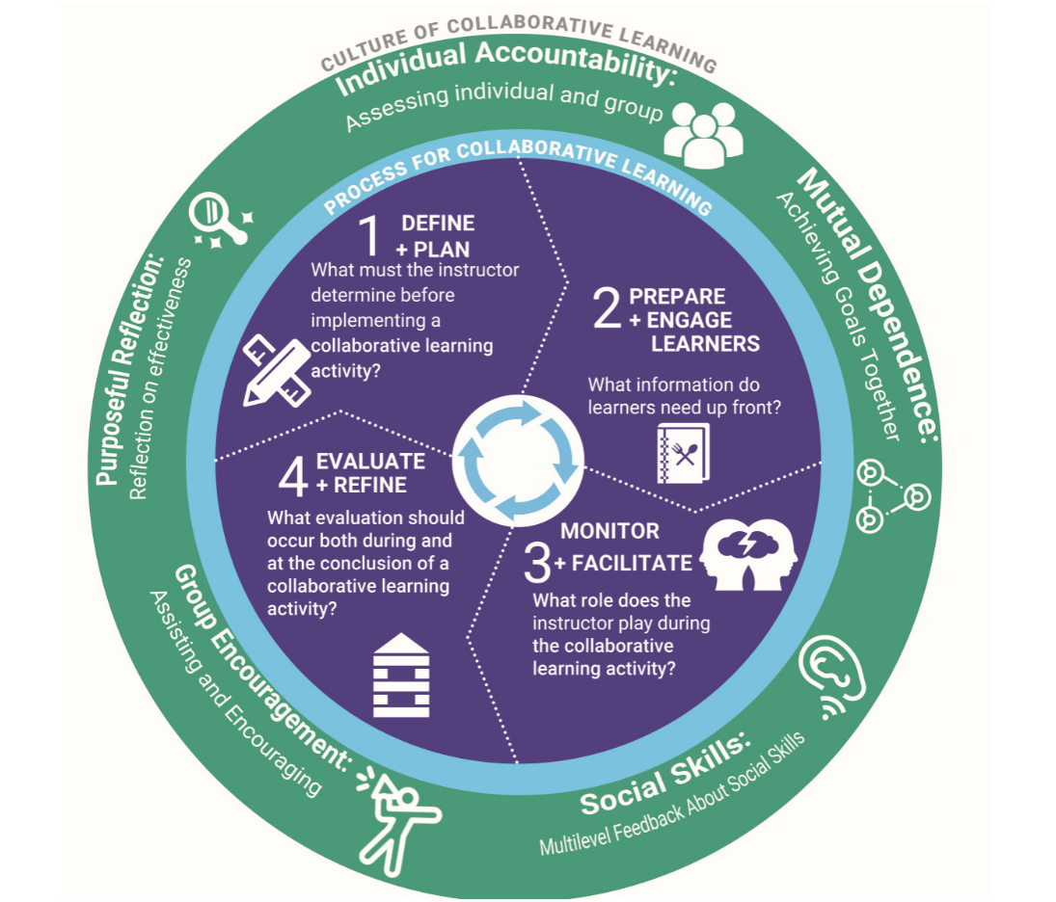
https://www.edelements.com/collaborative-learning-framework
Notes:
Narration:
The culture of collaborative learning framework is one of many that are applicable to online learning. Although we won’t focus on all aspects of the framework we will touch on how this can help you create assignments that are meaningful to the student. If you are interested in reading more about the framework, a free downloadable copy is available online. We will provide you with the link to the resource.

Slide 16
Where do I begin? Planning!
Decide why you are creating an assignment that gives responsibility to the students.
Where does this type of assignment fit in the curriculum?
How does this learning activity align with module and course objectives?
Does the task foster critical thinking, and in terms of nursing, clinical reasoning?
In terms of group structure, who will choose the groups? What are the roles, how are the roles assigned?
Notes:
Narration:
The WHY behind the assignment will be essential in the initial planning phase. There are many reasons why we shouldn’t be using collaborative assignments and one of those reasons (which yes, I’ve heard) is that it decreases the amount of grading for the faculty member. When creating an assignment, be sure that you are doing it for a good reason and that it’s not a “sounds like a good idea” situation. We should be using group work to enhance our course content and contribute to the curriculum. It must align with your module and course objectives in order for it to have value. The structure of the assignment should foster critical thinking and create what some refer to as the “productive struggle” which asks for the learner to work through tasks that have a difficult or more than one solution.
Online, especially if you are teaching in an accelerated format, it can be difficult to truly get to know your students. This can create a challenge when assigning students to groups. If you have a “meet and greet” forum in your course, you may be able to find some relevant information there. In my experience, the most efficient thing is to allow your learning management system to randomly assign the groups. If your learners are involved in the planning of the assignment, this may be when you purposely group those together who are interested in working on a common topic.
Another option is if you have 3 different topics to choose from for an assignment. If you are allowing them to choose a topic, this would be a time when they self-assign.
Provide the learners with examples of group structure and if you choose to do so, assign roles.

Slide 17
Get the Leaner Ready
Introduce the “what and why” of collaboration in your course as soon as possible.
Provide feedback to learner questions about the collaboration in a timely fashion.
Facilitate and encourage group socialization prior to the beginning of the work.
Help the student learn about groups.
Notes:
Narration:
Collaboration is an important skill in nursing. You can “sell” the assignment to the students to help engage them by reminding them that this is a skill they will be using throughout their career. Working with others from both personal and professional diverse back grounds contribute to knowledge well beyond the learning activity. Knowing up front that there will be collaboration better prepares them for success. Letting them know this information up front, such as in the syllabus, will be helpful.
As soon as collaboration is mentioned, the student questions start flying at you…. Be prepared to respond to those in a timely fashion. Some of the questions might be
Is this graded?
Who will assign the group roles?
What if somebody isn’t pulling their weight?
Answers to these will be course, assignment, and faculty dependent…. After you’ve “tested” the assignment a couple of times, you can come up with an “FAQ” sheet that answers
Consider using an icebreaker specifically for the group. Design an assignment that is of small point value (or no value) to get the group accustomed to working with one another. These can help to create a balance between the introvert and extrovert students.
It is not the sole responsibility of the faculty member to ensure the groups are functioning. However, we do need to provide guidance as to how to best engage as a learner. There are many resources that can help the group figure out how they’d like to structure for success. We’ll provide you with links to that information.
https://teaching.unsw.edu.au/sites/default/files/upload-files/student_working_in_groups.pdf
https://www.bgsu.edu/content/dam/BGSU/learning-commons/documents/writing/Guidewiredocs/Group%20Work%20Online.pdf

Slide 18
Types of Collaborative Assignments
Problem Based Learning
Group Discussions
Papers
Projects
Notes:
Narration:
This list is not all inclusive of course, but these are they types of collaborative assignments I have used in my courses.
PBL: The MSN nurse educator courses include learners that are in the academic setting and the hospital education setting. One of the learning activities in the course is “Making clinical assignments”. Initially this was not a collaborative effort but I noticed that the hospital based educators really struggled with it. I decided to make it a group effort and received positive feedback from both types of educators that they were able to learn things about this from each of the backgrounds (hospital vs. academic)
There are a couple of different approaches for group discussion that I take. In the MSN NE course, the students explore different methods of clinical instruction such as Traditional Model, Preceptor Model, and Partnership Model (DEU). The group works together to present their assigned model and then learn about the other methods when replying/engaging with the other groups. I’ve also used a case study approach in the RN-BSN leadership courses.
Papers are another method of collaboration online.
Projects and presentations offer the opportunity for collaboration on a topic of choice or an assigned topic.

Slide 19
Facilitating Collaborative Work
https://www.publichealthnotes.com/facilitation-vs-teaching-20-differences-we-must-know/
Notes:
Narration:
Your role is to facilitate in learning in group assignments. The learner “owns” the process of learning. You have developed the assignment, prepared the students and given group management strategies. Now it’s time for the student to pick up the work. You’ll continue to monitor progress and that can be accomplished in many ways. It should NOT be necessary for you to be involved in all of the discussions within the group.
Do consider “dropping in” to the discussion every now and then to evaluate progress and provide helpful suggestions. You could also design things such as a progress report for the group to turn in at certain times during the course to demonstrate progress. Another option is to require progressive drafts of the students work so you can see exactly where they are.

Slide 20
Evaluating Collaboration
Start with a well designed rubric available early in the course
Decide on what you are evaluating in the assignment
Decide who you will be evaluating
Peer Evaluations
Self-Reflections
Student evaluation of the assignment
Notes:
Narration: Collaboration can be a reliable and valid learning strategy if provided a well-designed rubric. I’ve always found it helpful to have the rubric available to the student so they are clear about expectations and how the grade will be determined.
Examples of group work rubric: https://teaching.cornell.edu/resource/example-group-work-rubric
http://www.readwritethink.org/files/resources/lesson_images/lesson819/GroupWorkRubricsChecklists.pdf
Are you evaluating the “act of group work” or just the product turned in by the group or both?
Are you evaluating the individual effort, the group effort, or both?
The final “product” submitted by the group doesn’t necessary reflect the effort of the individual members. Peer evaluation of collaboration can be a way the faculty to gain clarity about individual performance. These can be graded or not. The peer evaluation may or may not impact the final score of an individual.
Samples of peer evaluations:
https://www.northwestern.edu/searle/docs/History%20and%20Philosphy%20Self%20and%20Peer%20Evaulation.pdf
http://www.readwritethink.org/files/resources/printouts/Group%20and%20Self%20Evaluation.pdf

Slide 21
Quiz Yourself!!!
Which of the following is important to faculty managing the process of collaborative assignments?
Monitoring all communication in the groups to ensure each person is contributing
Allowing the students to build their own time line for due dates of the group project
Having clear objectives for the assignment so that the group knows what is expected to achieve success
Collaborative assignments can include projects, papers, and discussion boards.
True
False
Notes:
C and true

Slide 22
Transitioning a course from the classroom to online
Julie F. Hinkle PhD, RN, CNE
University of North Carolina Wilmington
Fall 2020

Slide 23
Learning Objective
Discuss strategies to adapt classroom lectures and learning activities into online format

Slide 24
Strategies for enhancing online “lectures” or learning lessons
Handouts
Power point
Lecture notes
Books
Articles
Websites
Worksheets
Notes:
Power points can also be used for online courses. Power points generally are bullet points and very to the point information and in a live lecture, you would expand on the information. One way to make enrich them is to add extra information in the notes section like I am doing here. (Voice over ppts I will discuss later in this presentation.) showing students how to view the notes section will be important if you choose to use this feature.
Lecture notes can also be used for online courses. I have written out versions of lectures in word files that I have posted online. Some of you may already have lecture notes written out for your f2f classes. This is another thing you can quickly make available to online students that can help them with the material. My notes are not precisely lecture notes but rather summaries of textbook content that I find the students have a hard time with that I write out in my own words with additional information from articles, websites, whatever.
Sometimes textbook readings are really ideal. A well written book can really help students learn content as can articles or websites.
One thing to consider is a lot of students do not read like we always want them to. Some have a hard time discerning what to focus on, others are intimidated by the volume of information and others …who knows!
Worksheets can be used to help guide students through written content. I have them do WYNTK sheets in patho pharm. In essence they are creating their own study guides

Slide 25
Video Lecture creation
Voice over Power Point
Whiteboard
Voice Thread
Youtube
Considerations for video creation
Sound and video quality
Hosting
Length of video
Notes:
A common way to enhance lecture type content is to add audio/visual layer to your content. Voice over ppt is a quick and easy way to do this. All you need is ppt and a webcamera which most have.
There are other tools you can use to create audio-visual content for your course. One popular thing to do is a whiteboard style presentation. This can be done using a variety of apps like screenchomp and others and zoom also has a whiteboard feature. For those that do not like having their face on a video presentation, but do not want to do a voppt, this might be appealing.
Voice thread is a feature on canvas that can be used if this is your lms
You tube also can be used to create videos. The nice thing about youtube is the automatic closed captioning that youtube can do for your videos.
What you use to create video lectures is a personal preference and an $$ but there are some fundamentals you need to consider.
Good sound quality
How to host content
LENGTH OF VIDEO!!! DO not make long videos..absolutely no 3 hr lectures! You need to focus on challenging content for your videos and keep it to the point. Preferably 5 minute video length but should aim for no longer than 20 minutes.

Slide 26
Videoconferencing
synchronous vs asynchronous
“flipped” or Q&A or data driven
Notes:
Zoom and other video conferencing tools for synchronous or ansynchronous classes.
If live need to consider security features so you do not get “zoom bombed”
Would still recommend short and to the point if doing “lecture”
Try flipped…don’t necessarily call it flipped but do activities like you would in the classroom..can still do this online!
Data driven. Use info to decide what is the areas you need to focus on…good idea for all of your “lectures” use quiz data, Q&A boards for instance

Slide 27
Alternative Learning Activities
Free or publisher videos
Formative assessment activities
Games
Cases and virtual simulations
Escape rooms
Scavenger hunts
And more!
Notes:
See useful links!

Slide 28
Useful links
Popplet: Digital mind map available on the web or in iTunes. Exports as an image or PDF. http://popplet.com/
Goosechase: Scavenger hunt that tracks team progress in real time. https://www.goosechase.com/.
StoryboardThat: Create storyboards to tell a story or show a concept. Large library of characters and settings. http://www.storyboardthat.com/.
Knightlabs: Northwestern University Lab that builds tools to help people tell stories. https://knightlab.northwestern.edu/
Wizer: Worksheet creator without needing a printer. Create your own or use/edit a worksheet created by other users. http://app.wizer.me/.
Vizia: Make YouTube videos interactive with questions. Data/feedback goes to Google Drive spreadsheet. https://vizia.co/.
Plickers: formative feedback on big concepts and key skills. No log-in. https://plickers.com/.
Socrative: another formative feedback app. https://socrative.com
Screencast-o-matic: free screen recording for up to 15 minutes. https://screencast-o-matic.com/.
Awwapp: Online whiteboard with real-time visual collaboration. No log-in, share link and go. https://awwapp.com/.
Pexels: Free stock photos without need for attribution. Branch of resources for videos. https://www.pexels.com/.
Unsplash: Free images with easy citations. https://unsplash.com/.
Bensound: Royalty-free music and music clips https://www.bensound.com/.
Notes:
I shared these useful links at my last NCLN presentation, fyi…which is available for NCLN members on our website!

Slide 29
Useful links 2
Voicethread: https://voicethread.com
Ipad app resources: http://www.appsinclass.com/previous-apps-of-the-week.html
V-Sim: https://www.laerdal.com/us/products/courses-learning/virtual-simulation/vsim-for-nursing/
ShadowHealth: https://www.shadowhealth.com/
Virtual Clinical Excursions: https://evolve.elsevier.com/education/nursing/virtual-clinical-excursions/
NLN Institute for Simulation and Technolgy: http://www.nln.org/centers-for-nursing-education/nln-center-for-innovation-in-education-excellence/institute-for-simulation-and-technology
Educause: https://www.educause.edu/
Online Learning Consortium: https://onlinelearningconsortium.org/
Office Of Educational Technology: https://tech.ed.gov/blog/
Merlot: https://www.merlot.org/merlot/

Slide 30
Useful links 3
EdTEch Update: https://www.edtechupdate.com/
Kathy Shrock's Guide to Everything: https://www.schrockguide.net/
Free Technology for Teachers: https://www.freetech4teachers.com/
Edutech for Teachers: http://edutech4teachers.edublogs.org/
The Nerdy Nurse: 9 fun and educational nursing games: https://thenerdynurse.com/9-fun-and-educational-nursing-games/

